Slide 1
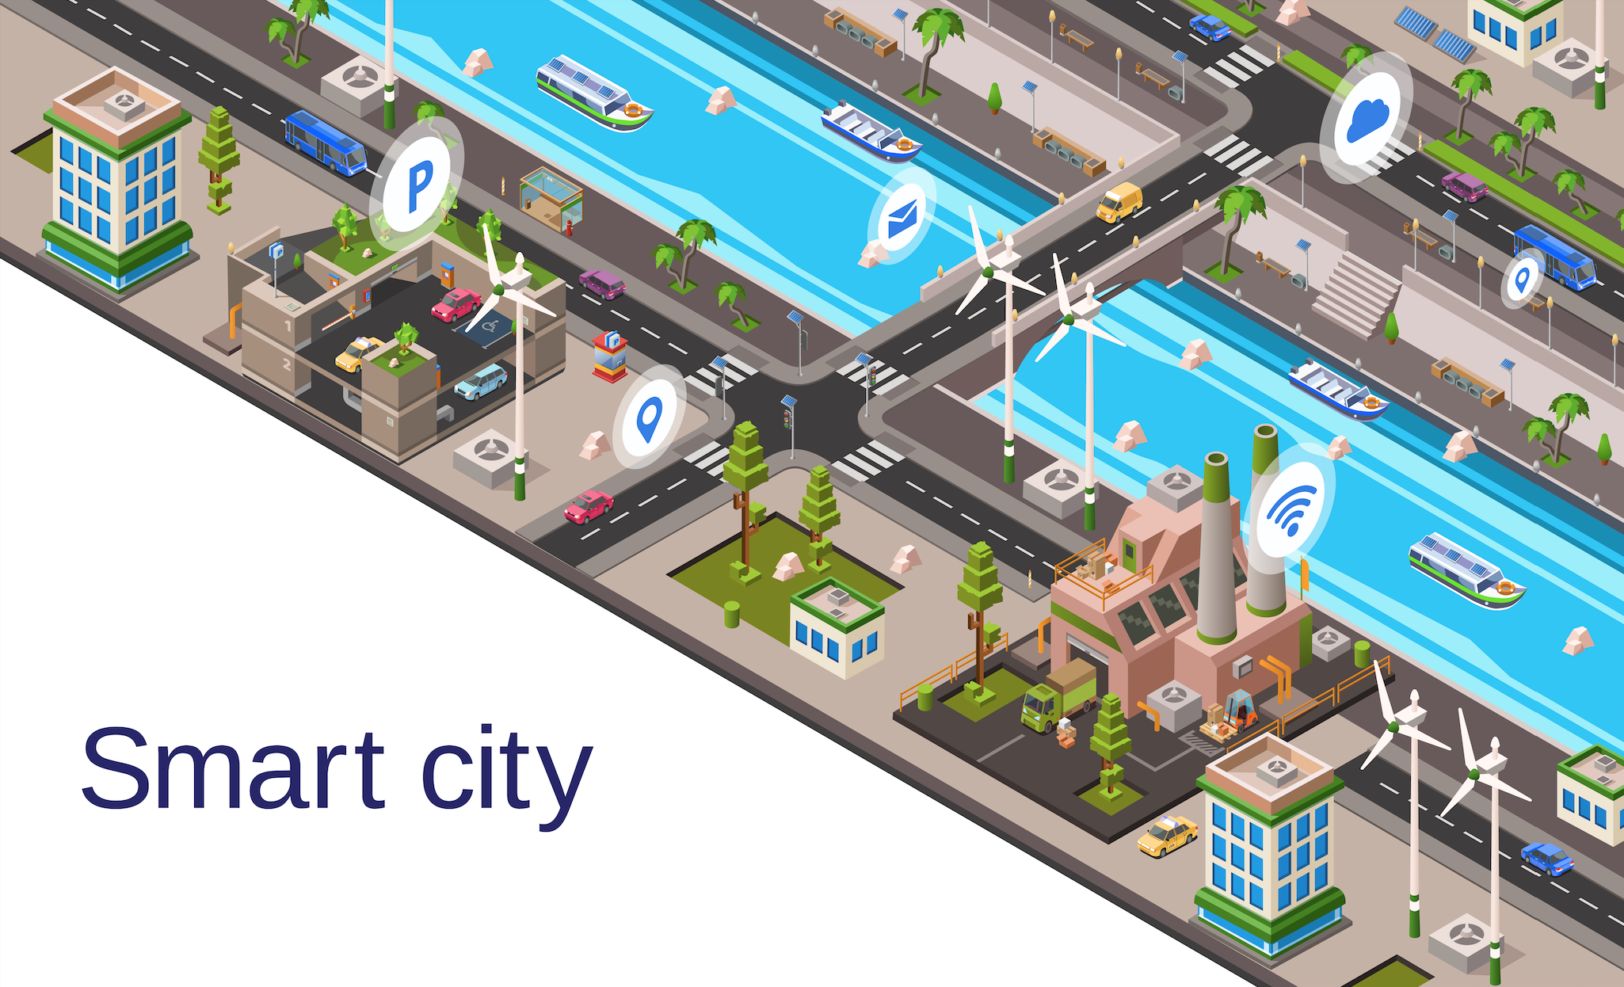

UniJagung
Consultation Co.

Slide 2

Maximizing Social Impact
Maximizing Profit
Thru New Data Insight

Slide 3
Problem Statement (In the context of Low Carbon Mobility)

Slide 4
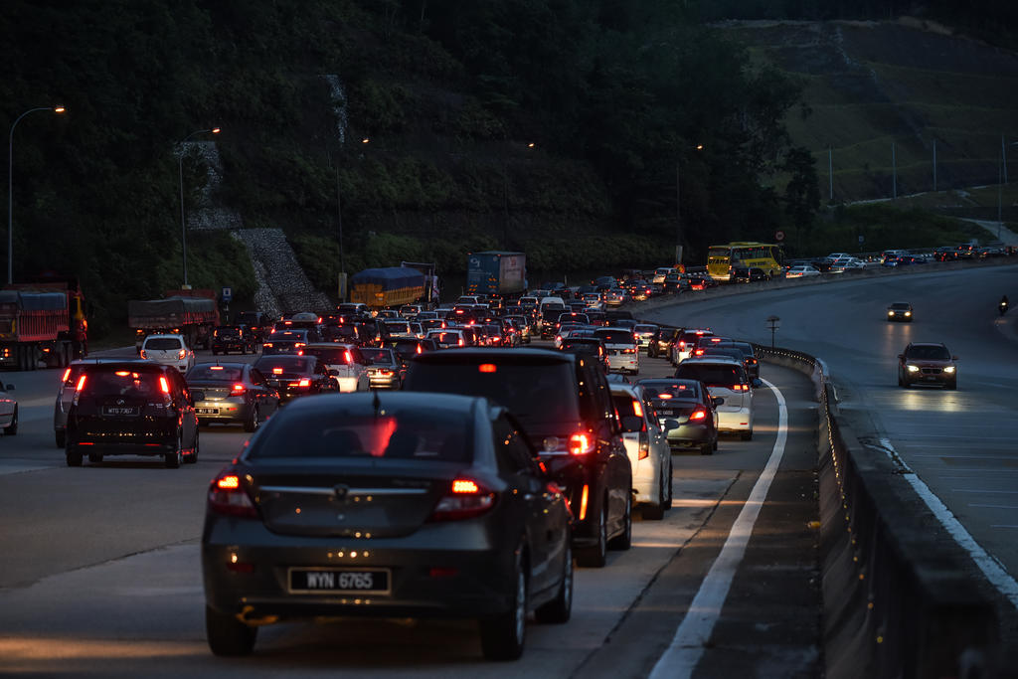
Number of cars are on the rise. Congestion is here to stay. Time stuck in a congestion is a significant fraction of commute time for city drivers. Worse is when most of the car carbon emission is a result of the car sitting still doing nothing. What can GoCar do ?

Slide 5
Stop Guessing, Start Leveraging

Slide 6




Multiple Domain Insight: Multiple Datasets
CRM
Boost
POI & Event Log
GoCar
Campaign
Purchase behavior
Lead behaviour identification
Shared mobility preference
Demographic by APRU, Gender

Slide 7
Opportunities
Identify potential customers for GoCar. Targeted marketing/promo campaign results in stronger participation
Identify optimal location for GoCar sharing station based on customer route prior and after GoCar service.
Collaboration with high potential merchant where GoCar customer frequent for promotional event/campaign for visibility.

Slide 8
Business Impact

Slide 9
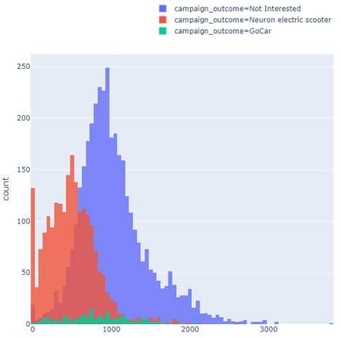
Business Impact
Targeted Marketing
Money & Effort spent at the right place
Understand customer demographic, routine and behaviours
Improve customer retention

Slide 10
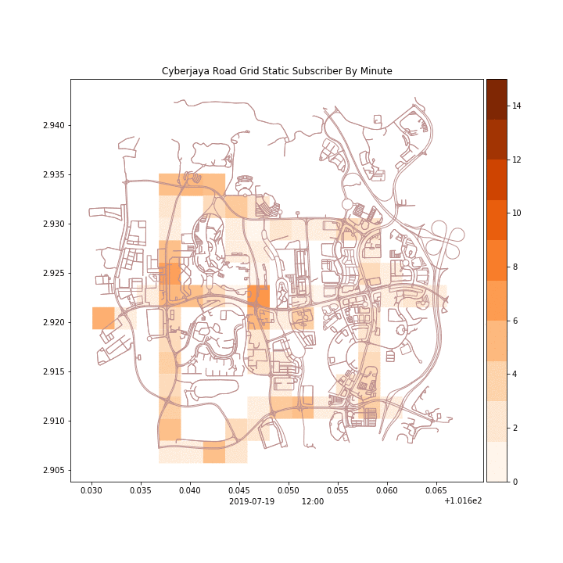
Business Impact
First to know:
Tracking customer mobility anonymously.
Machine learning identify breakdown pattern before being notified
Proactive customer service care

Slide 11
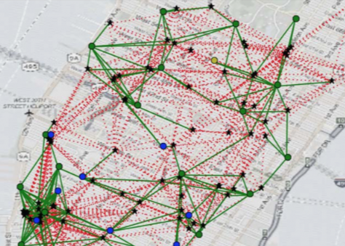

Business Impact
At the right place:
Building GoCar sharing station at where it matters.
Identify high density intersection of user trajectory for planting infrastructure.

Slide 12
Social Impact

Slide 13

Social Impact
Reduce Car
Ownership
Encourage public transportation
Improve traffic thru better adoption on public commute
Less traffic less emission

Slide 14

Social Impact
Affordable mobility
Pay per use
Reduce commute time
Changing spending behaviour

Slide 15
Implementation

Slide 16
Data Driven Implementation
Analysis
Descriptive
Predictive
Prescriptive
Multi-domain Datasets
Data Driven Decision
Business & Social Impact

Slide 17
Descriptive Analysis:
Describe customer demographic, buying behaviour, habit and routine
Dataset:[CRM, Boost Transaction, Event Log, POI]
Predictive Analysis:
Predict potential customer for marketing strategy.
Forecast region density for potential GoCar station placement.
Dataset:[CRM, Boost Transaction, Event Log, POI, Past GoCar Campaign Result)

Slide 18
Prescriptive Analysis:
Journey anomaly detection based on event log and prescribe recommendation
Dataset:[Event Log]

Slide 19
Business Model

Slide 20
Key Partners
Government
Telco
Electronic payment service like Boost, Fave, etc
Value Proposition:
Convenient affordable on demand car for hire.
All inclusive(except fine), just order and drive.
Enjoy exclusive discount with our partner merchant.

Slide 21
Revenue Stream
Pay per use on GoCar services
Channels for customer attraction
Discounted rate with subscription plan for regular customer
Gamify rewards when user spends with GoCar and Client.

Slide 22
Governance & Ethics

Slide 23



Censored Sensitive Data
Bias Mitigation
Open Source Dataset
No breach to privacy & security!
Everyone is equal!
Foster public contribution

Slide 24

Thank You

Slide 25

Business Impact
Added Value:
Carpooling option possible
Eg:
A going to X passing Y
B going to X from Y
B request carpool at a fee
A accept

Slide 26
Action Plan
Identify potential opportunity based on interest dataset & mobility projection.
Identify bottleneck for street planning (based on peak spreading & air quality). Improve output of citizen.
Collaboration across sectors.

